Slide 1
The Colonization of Africa part 1
European Conquest and Rule
Late 1800s into the 1900s

Slide 2
LATE 1800s the Colonization of Africa
European exploration increased in the 1920s
occupation was well underway in Africa – by 1870
1885 approximates the official beginning of the colonial era
----+---------+-------+---------+---------+--------------------
1800s 1885 1900s 1945 1958 … 62…
marks autocratic phase of colonial rule when Africans had few political and civil rights
Notes:
Autocratic: A person is autocratic when he takes no account of other people's wishes or opinions
An autocracy is a system of government in which supreme power is concentrated in the hands of one person, whose decisions are subject to neither external legal restraints nor regularized mechanisms of popular control

Slide 3
Early 1880s
due to Africa's valuable resources such as gold, timber, land, markets and labor power; European interest in Africa increased dramatically.
European maps of the continent thereby delineating the rough areas of British, Portuguese, French, and Belgian control.

Slide 4
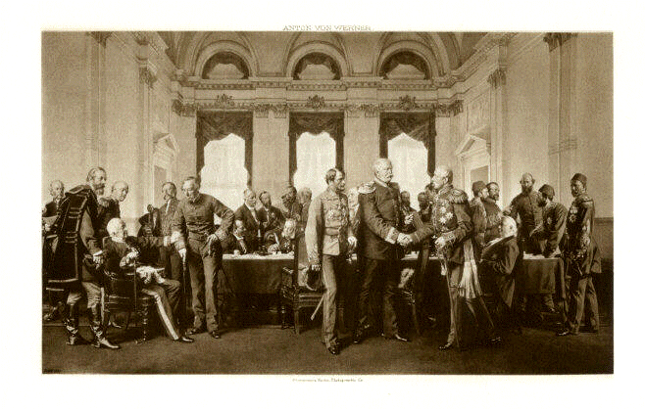
European diplomats
Berlin conference of 1884-85
Notes:
http://cdn.dipity.com/uploads/events/2b4925d6fe96929dcb172c65a34dcf41_1M.png
www.dipity.com/chelseaface/ Unit-5-Timeline_1/

Slide 5
Europeans plan to rule the continent
Berlin conference of 1884-85
Formally sanctioned the partition of the African continent among several European powers
Under the expectations of an expanding world capitalist system
Legitimized what was called the “Scramble for Africa”

Slide 6
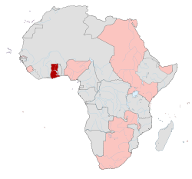
Africa is divided up in a hodge-podge manner, and handed over
Great Britain
British colonial Africa
Leading the industrial revolution Britain obtained the most valuable regions
Notes:
http://upload.wikimedia.org/wikipedia/commons/thumb/8/86/Colonial_Africa_1913_Gold_Coast_map.svg

Slide 7
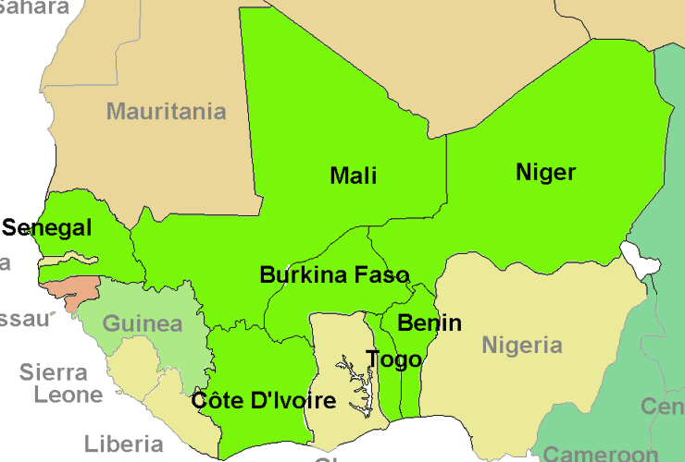
Francophone West Africa
France has more in the north
Encouraged by Germany, France acquired a large number of colonies due to the provinces lost to Germany during the Franco-Prussian war of 1870-71.
Notes:
Map of francophone West Africa
“Engage civil society to protect ‘tenuous transition in Guinea and Niger.” Dominique Dieudonné. Democracy Digest
http://www.demdigest.net/blog/wp-content/uploads/2011/08/francophone.gif

Slide 8
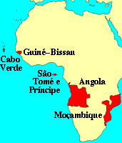
Lusophone Africa
(Portuguese)
Portugal received the territories of Angola, Mozambique, Portugues Guinea, islands off the coast São Tome and Príncipe.
Notes:
Map on Lusophone Africa
Diane Marie Amann. IntLawGrrls: voices on international law, policy, practice. Accessed August 26, 2011.
http://www.leca.ufrn.br/~adelardo/images/lusafric.gif

Slide 9
Other countries were assigned…
Belgium: Congo Free State, Belgium Congo (now Zaire).
Italy: gained colonies in Lybia and Somalia
Germany: German East Africa: Southwest Africa, Togo and Cameroon, but all were lost following WWI.

Slide 10
And the rest …
Spain: Spanish Sahara and equatorial Africa.
The only two African States to retain their sovereignty during the colonial era was
Ethiopia and
Liberia (founded in 1821 by freed African American slaves.)

Slide 11
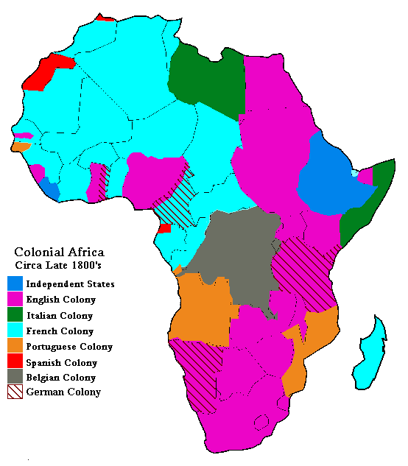
Notes:
http://mama.indstate.edu/users/geboen/ch3_afrcol.gif
mama.indstate.edu/ users/geboen/ch3_s00.html

Slide 12
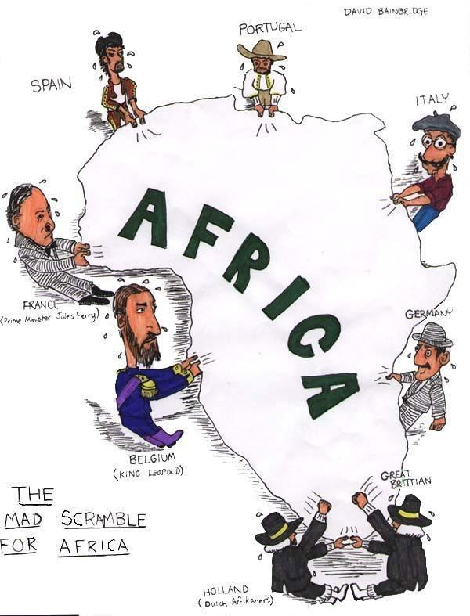
Notes:
http://a1.ec-images.myspacecdn.com/images01/44/70cada145425fa47e8847e003d853145/l.jpg

Slide 13
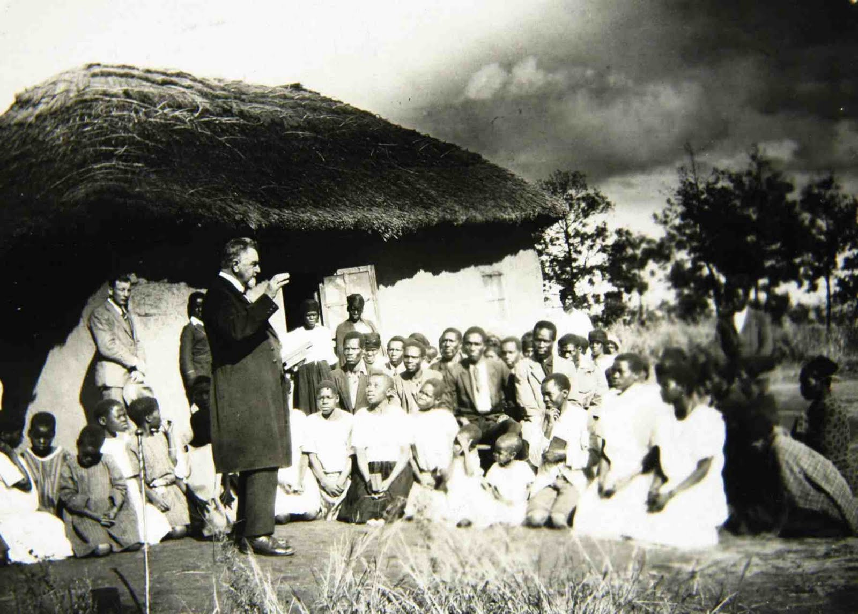
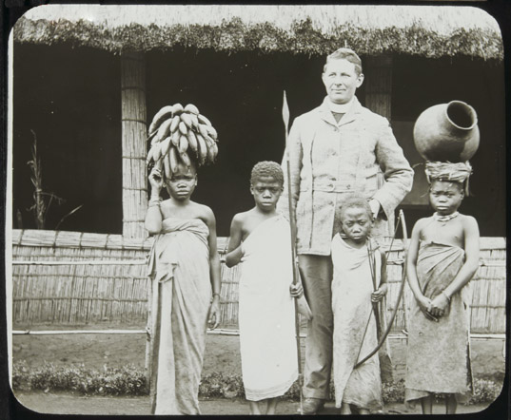
Missionaries (Religious leaders) from Europe, both Catholic and Protestant
were focused on the conversion of Africans to the Christian faith
Missionaries built numerous churches all over Africa
and ran Christian-based schools

Slide 14
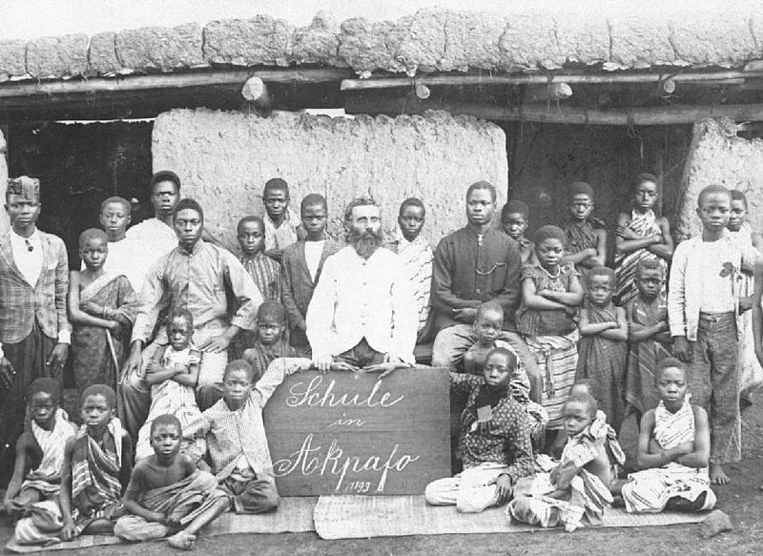
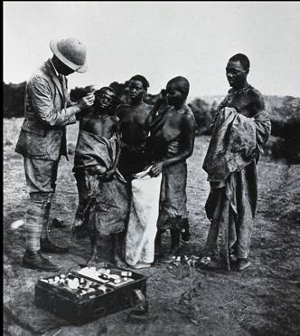
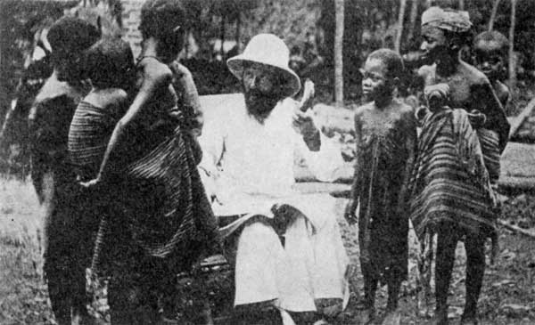
Missionaries worked tirelessly to teach Africans and were running European systems of education and medical care while condemning traditional youth formation rituals and methods of healing

Slide 15
Colonialism in Africa
Colonialism in Africa 3:2 min.
http://www.youtube.com/watch?v=47wyvMv5ba8&feature=related

Slide 16
Berlin 1885: The division of Africa
Berlin 1885: The Division of Africa- Icarus Films (trailer)
http://www.youtube.com/watch?v=FTjBNppdk-M&feature=related
Imperialism in Africa – Part 1 7:23 minutes
http://www.youtube.com/watch?v=YwUtxSoDQfw&feature=related
Imperialism in Africa -Part 2 5:19 minutes
http://www.youtube.com/watch?v=nWSwaZvJy88&feature=relmfu
Notes:
Berlin 1885: The Division of Africa- Icarus Films trailer
Imperialism in Africa – Part 1 7:23 minutes
Imperialism in Africa – Part 2 5:19 minutes
Impact of the colonization on Africa – spoof on the Berlin Conference and other European mishaps in their attempts at colonization. 7:00 minutes

